Slide 1

Southwest Riverside County Association of REALTORS
Grant Yates, City Manager
June 19, 2014

Slide 2

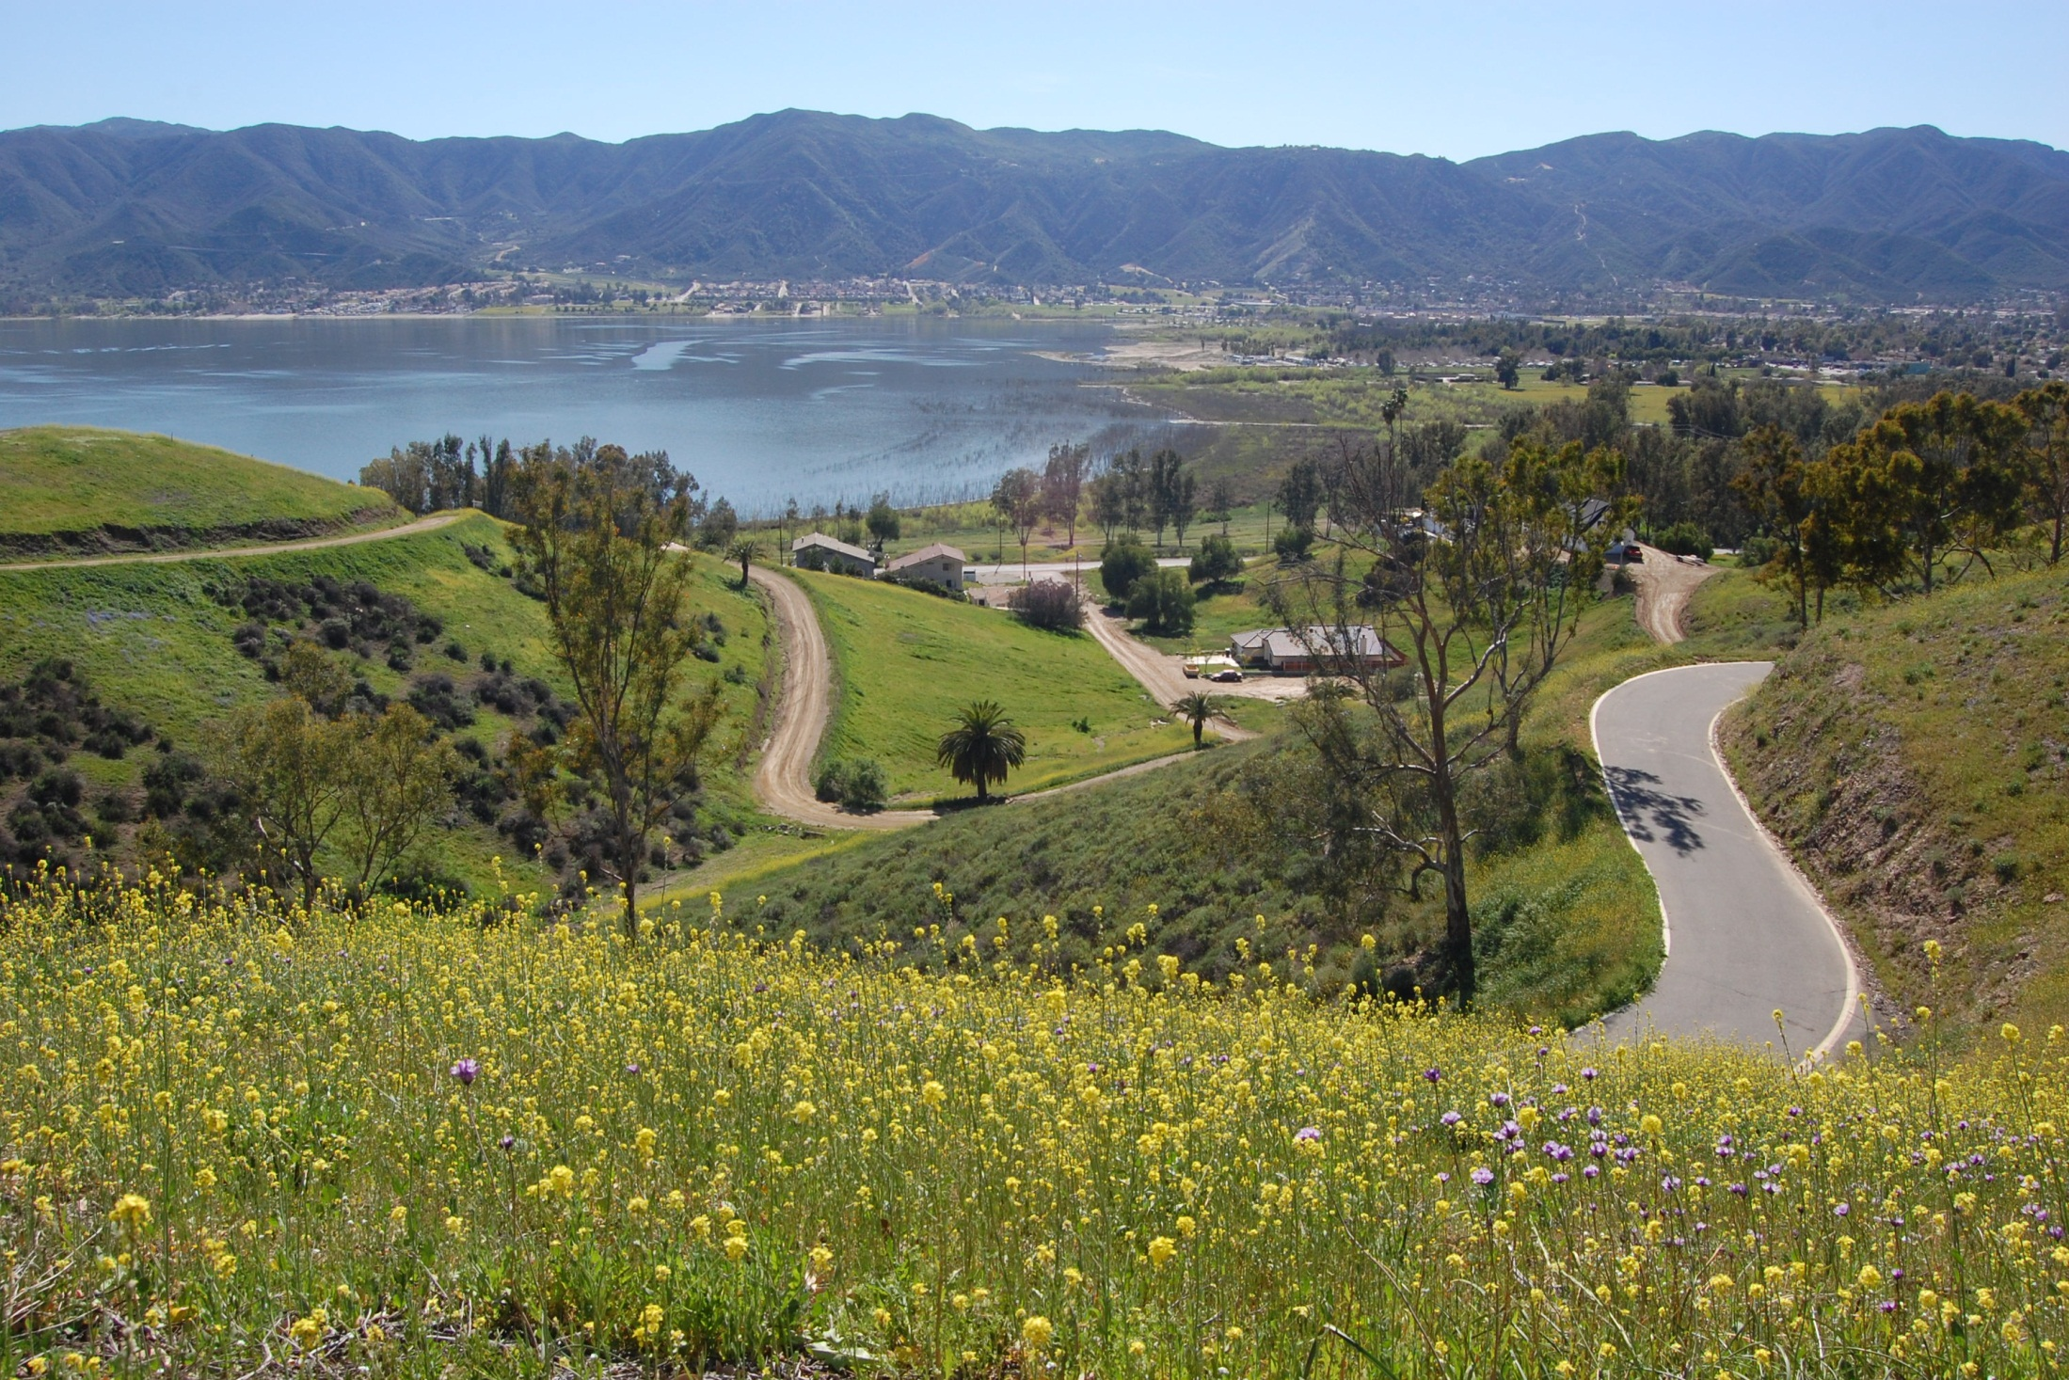
Extreme Beauty

Slide 3
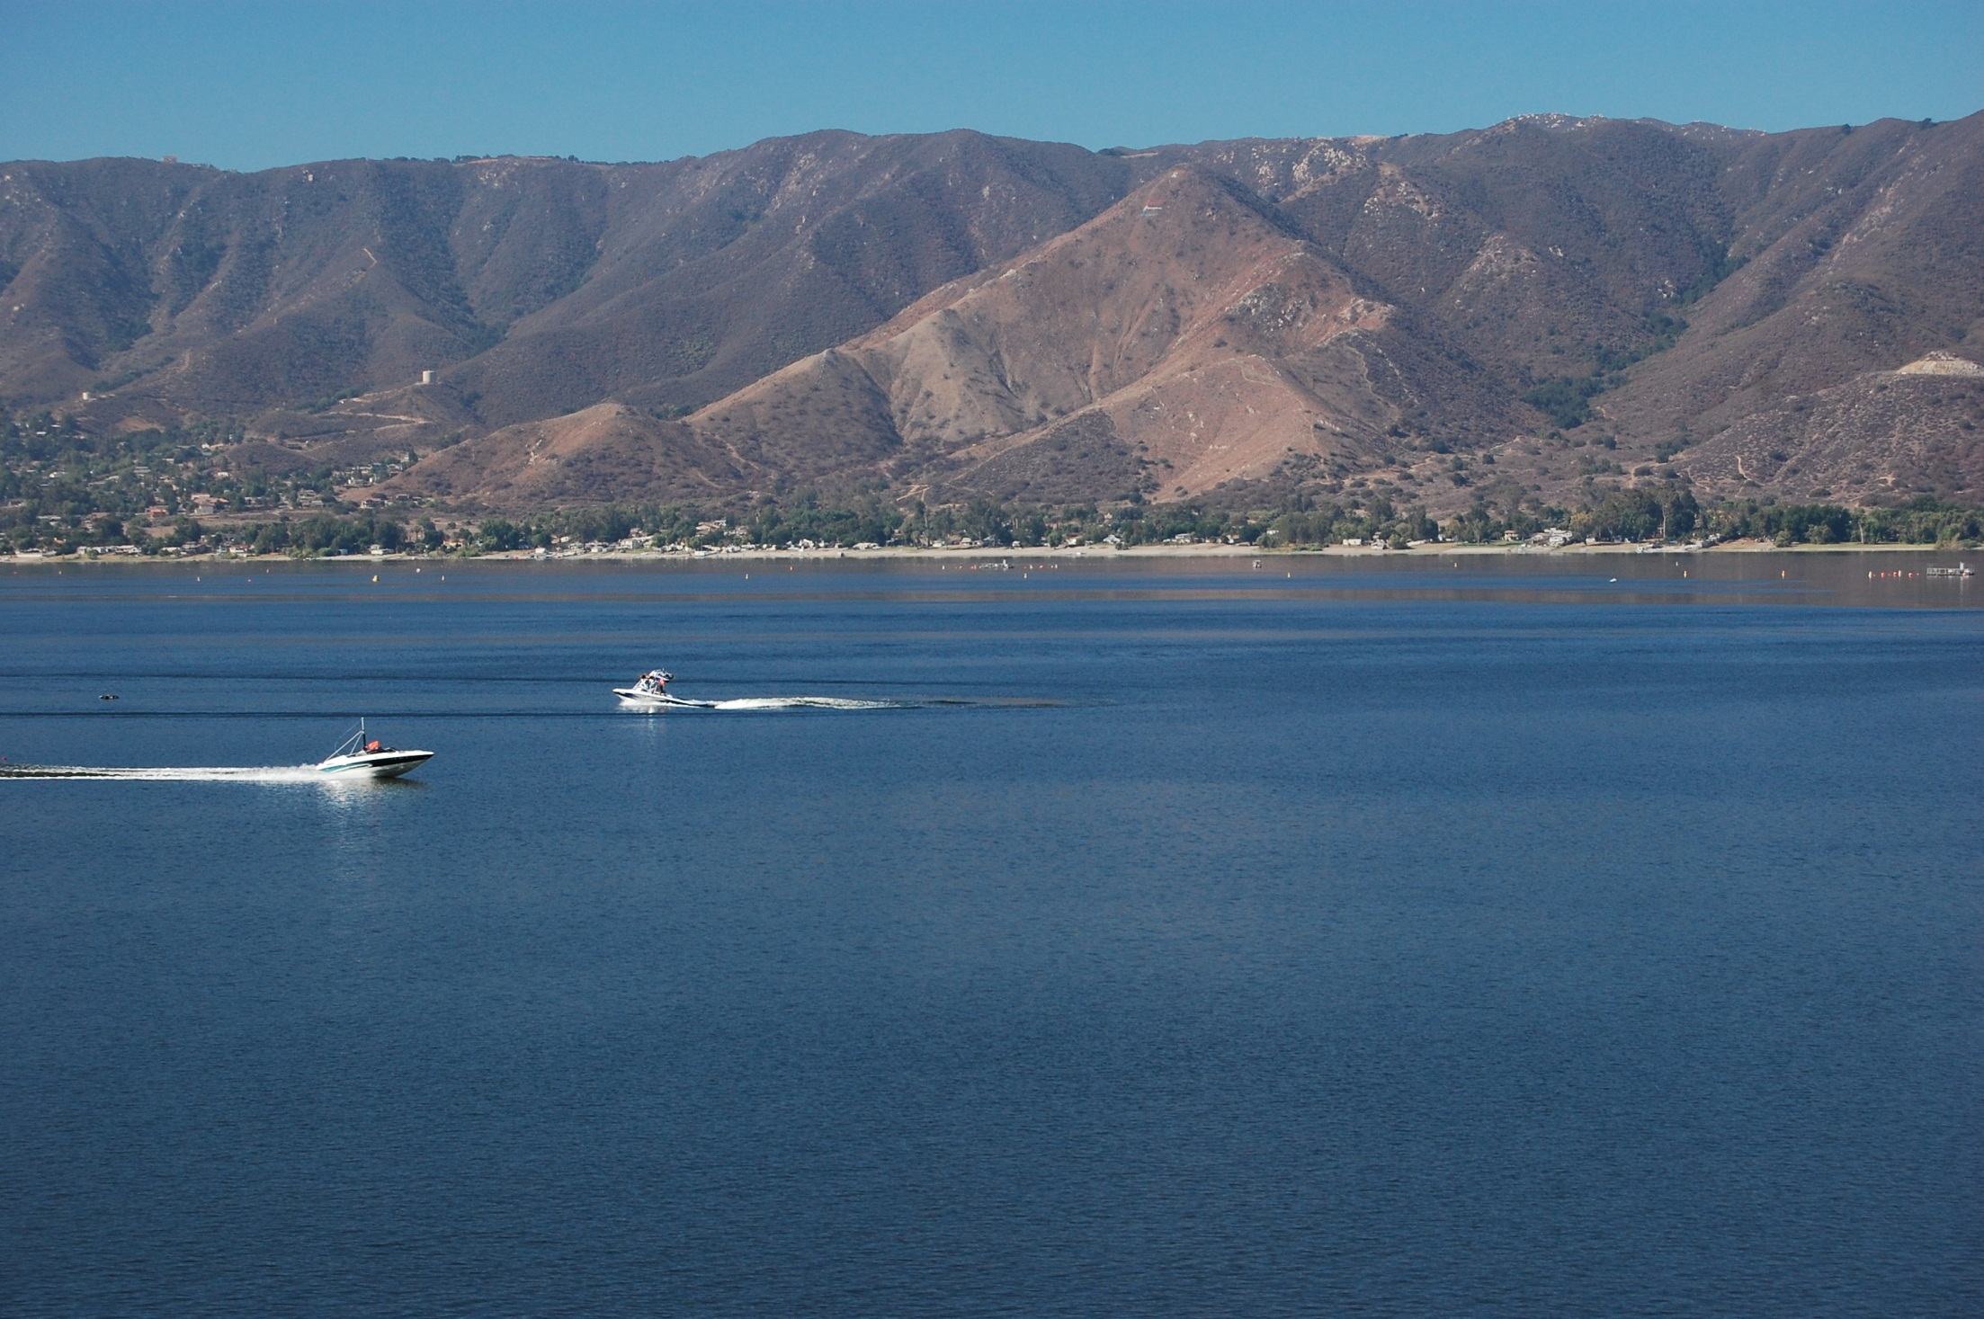
Extreme Beauty

Slide 4
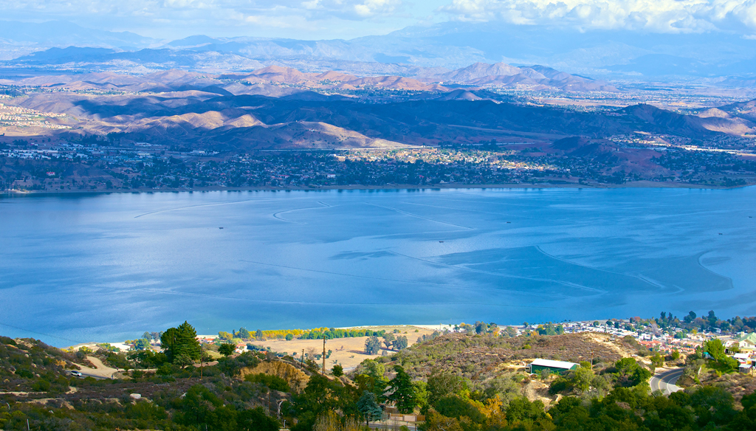
Fastest Growing City
56,718 residents
43 sq. miles
$64,327 median income
3.5 median household size
30.5 median age
Only 30% Built Out

Slide 5
New Single Family Homes
700+
New Homes/Year

Slide 6
New Development

Slide 7
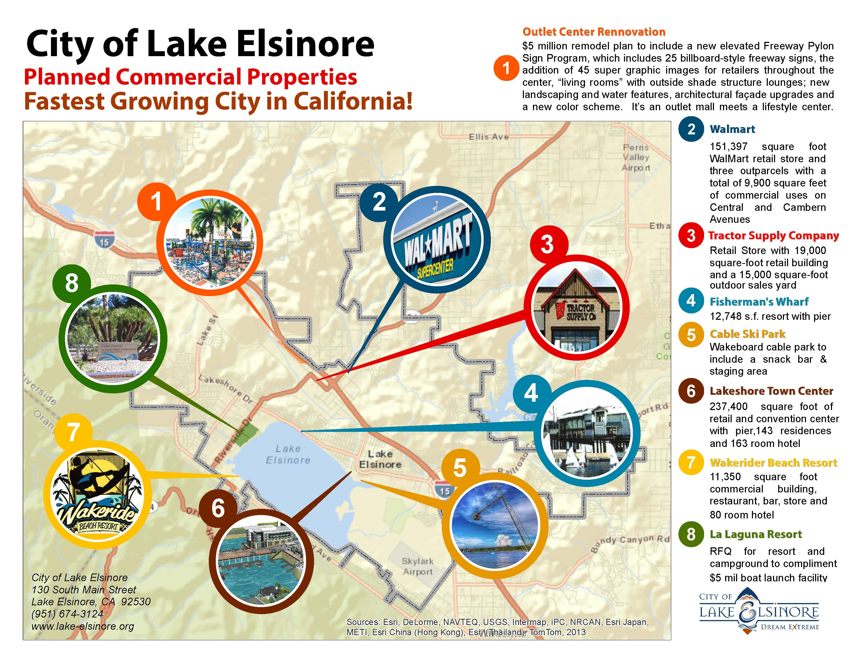
Commercial Development

Slide 8
Planning for the Future
East Lake Specific Plan
Drainage & Facilities Master Plans
Nexus Studies
Parks Master Plan Update
Alignment Studies
$26 Million Capital Improvement Plan

Slide 9
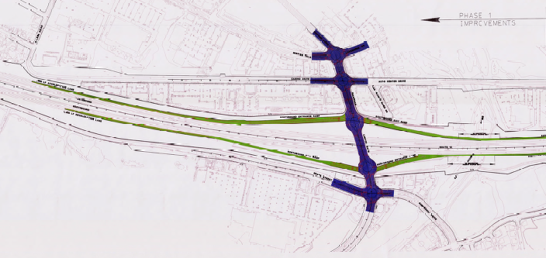
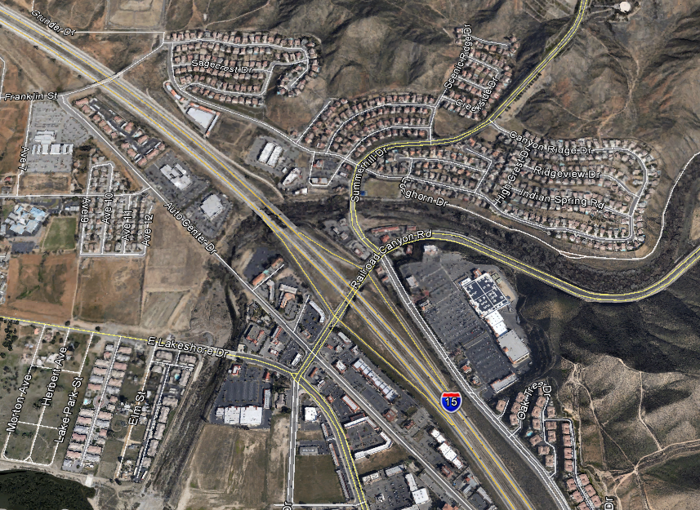
I-15/Railroad Canyon Ultimate Interchange
Plan Approval & Environmental Document (PA & ED) phase.
Funded through TUMF cooperative agreements.
Improved circulation, freeway access, and
eases congestion.
BUDGET: $2,200,000
VICINITY MAP

Slide 10
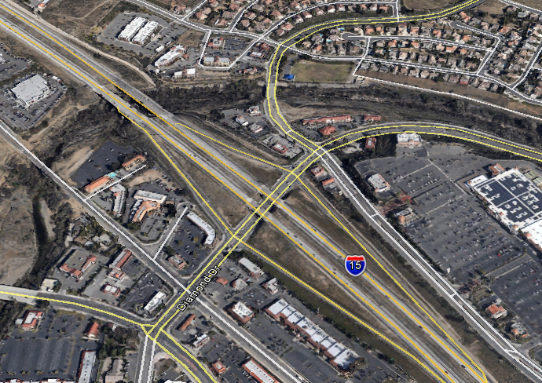
I-15/Railroad Canyon Road Deceleration Lane
Additional lane on southbound off-ramp.
Supports local and regional transportation needs by:
  Reducing traffic congestion
  Improving motorist safety
Cooperative agreement with Caltrans.
I-15 S/B Exit Ramp
BUDGET: $800,000

Slide 11
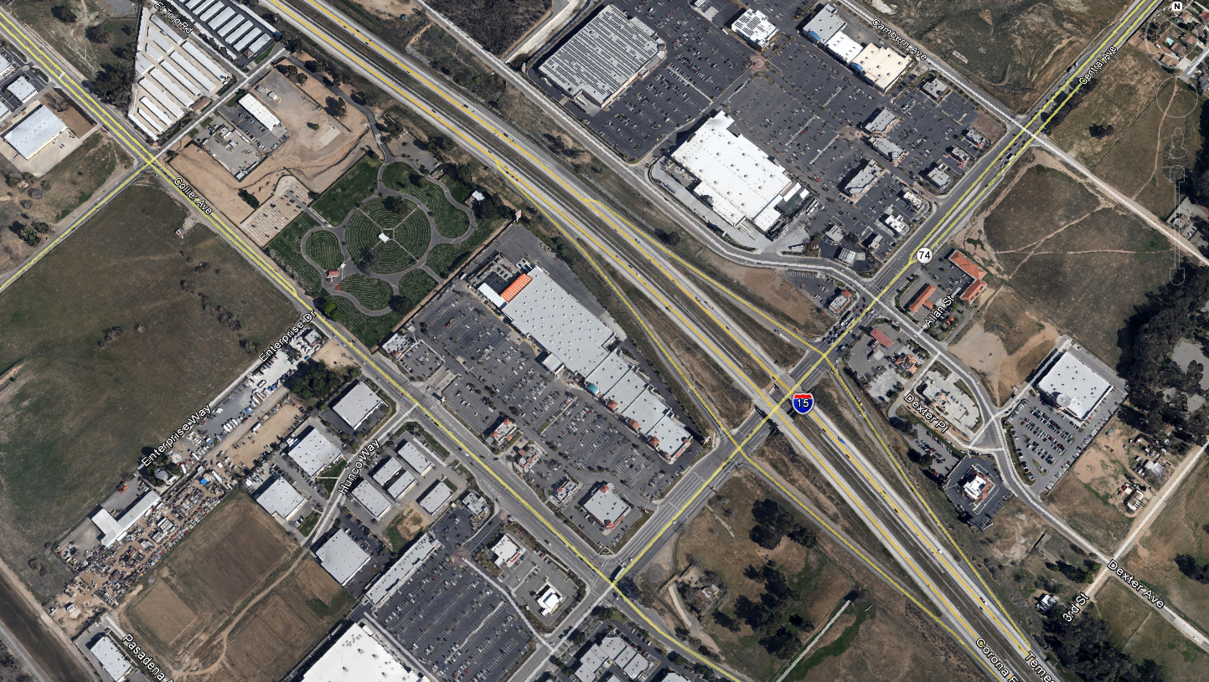
I-15/SR-74 (Central Ave.) Interchange
BUDGET: $1,083,000

Slide 12
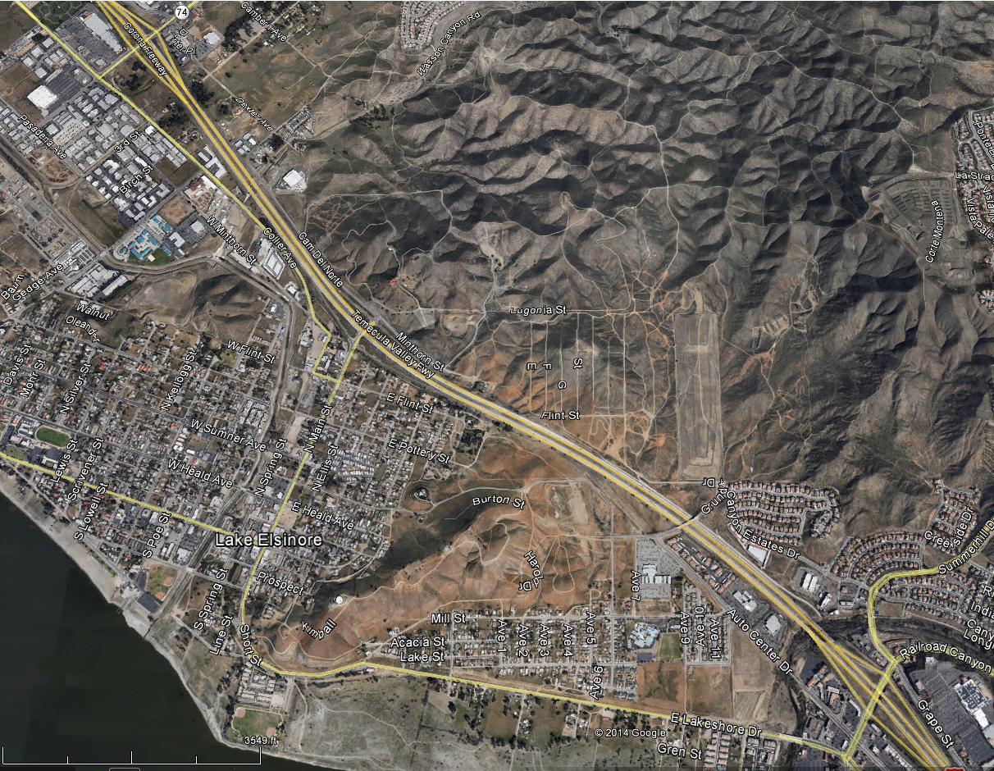
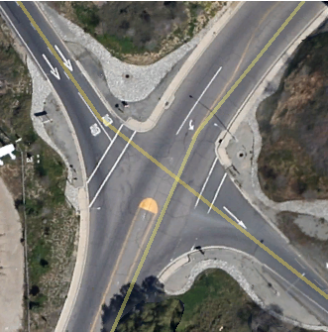
Main Street Interchange
Project Study Report Preparation (PSR)
  Analyze for projected traffic flow at build-out.
  Will recommend up to three design configurations.
  First step toward Design & Environmental approval.
I-15/Central Ave Interchange
I-15/Railroad Canyon Interchange
BUDGET: $400,000

Slide 13
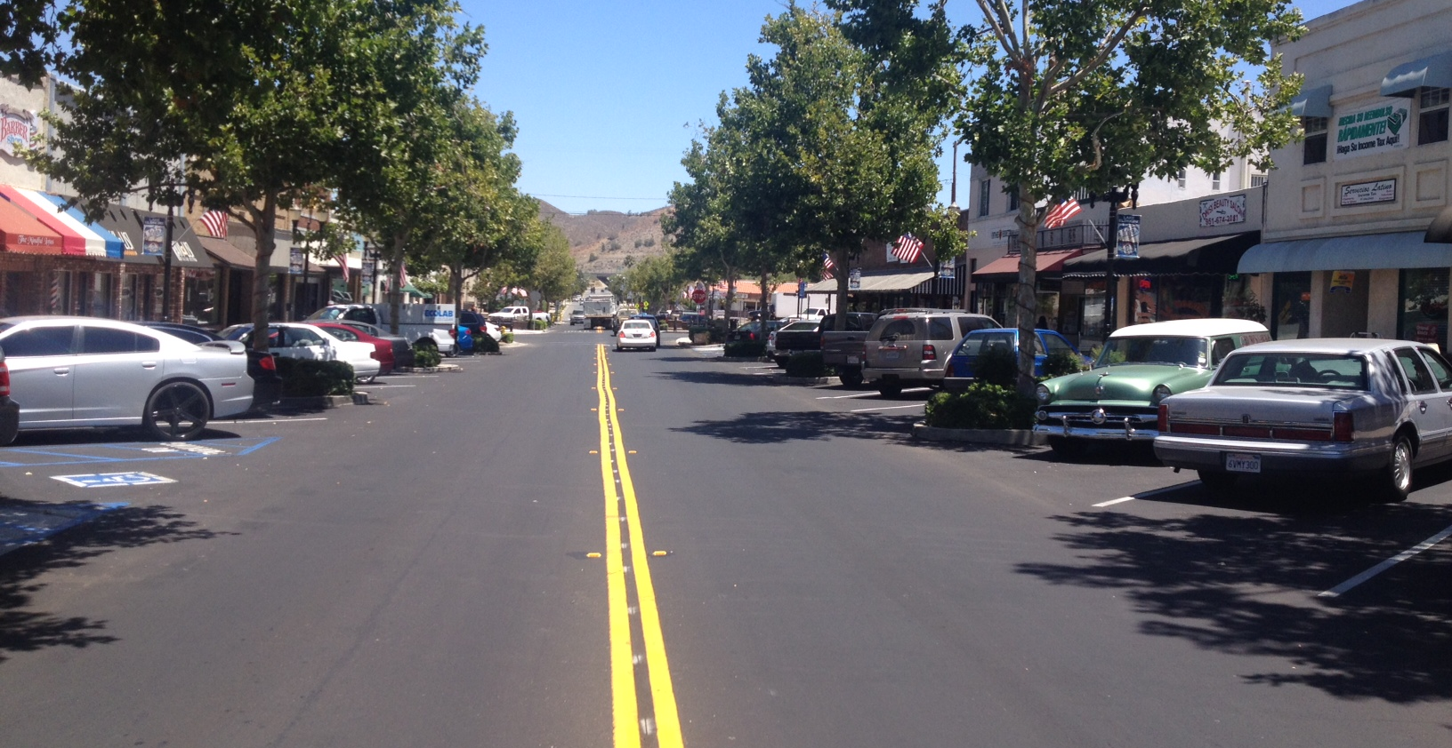

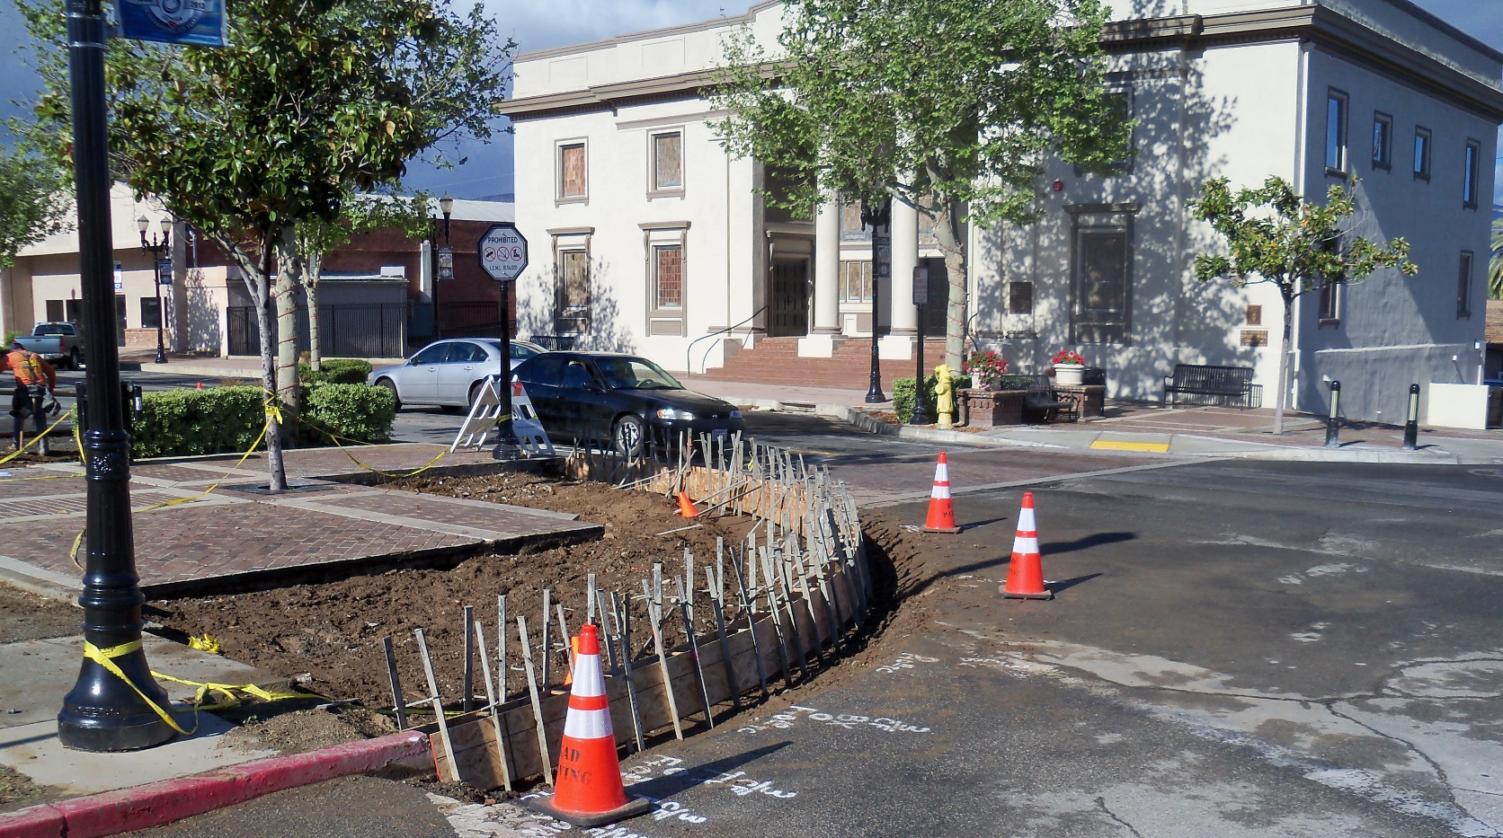
Historic Main Street

Slide 14
Connect with Us!
Like Lake Elsinore City Hall on Facebook
www.Facebook.com/CityofLakeElsinore
Follow us on Twitter:
@CtyLakeElsinore

